Slide 1
A SEMIPARAMETRIC MIXTURE METHOD FOR LOCAL FALSE DISCOVERY RATE ESTIMATION FROM MULTIPLE STUDIES
BY SEOK-OH JEONG, DONGSEOK CHOI AND WONCHEOL JANG

Slide 2
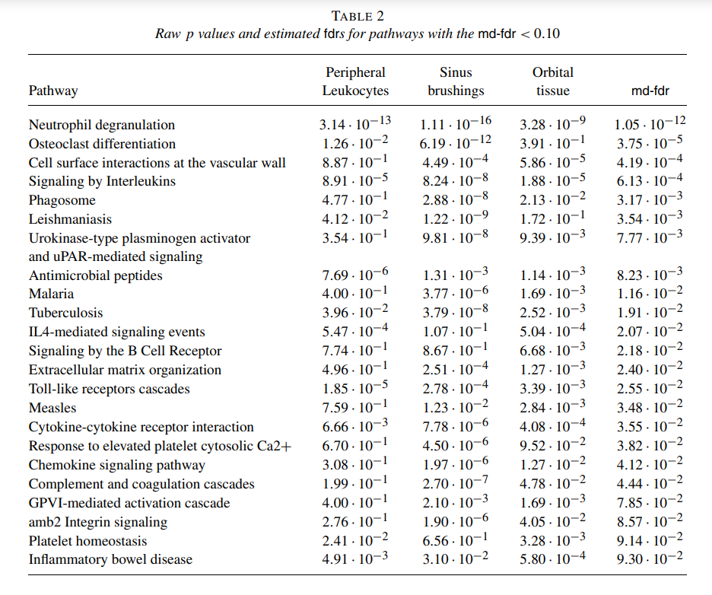
Abstract
Antineutrophil cytoplasmic antibody associated vasculitis (AAV) is extremely heterogeneous in clinical presentation and involves multiple organ systems.

Slide 3
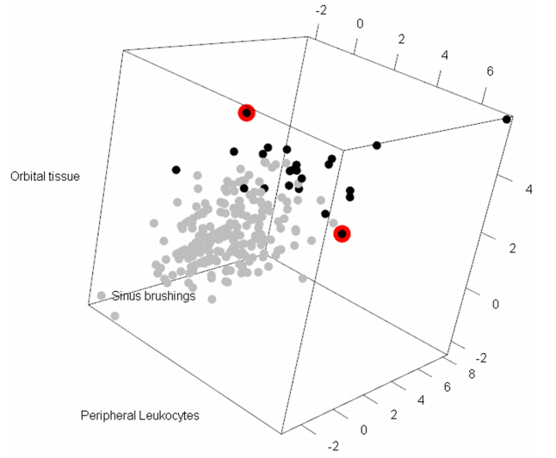
Abstract
We hypothesized that all AAV share common pathways and tested the hypothesis based on three different microarray studies of peripheral leukocytes, sinus and orbital inflammation disease
FIG. 1. Probit-transformed p-values of common pathways from three AAV microarray studies.
Black points represents md-fdr < 0.1
The red circled points are osteoclast differentiation (K) and cell surface interactions at the vascular wall (R).
Notes:
common pathway라는 게 AAV의 종류가 다양한건지? 어떻게 다양한건지?
이 때 정확히 hypothesis가 뭔가?

Slide 4





Introduction
Let $z_{i}, i=1,2,…N$be the probit-transformed p-values. $p_{0}=\operatorname{Pr}\left\{null\right\}$ and $p_{1}=\operatorname{Pr}\left\{alternative\right\}=1−p_{0}$
where f0(z) and f1(z) are null and alternative densities
local false discovery rate
Our goal is to estimate

Slide 5

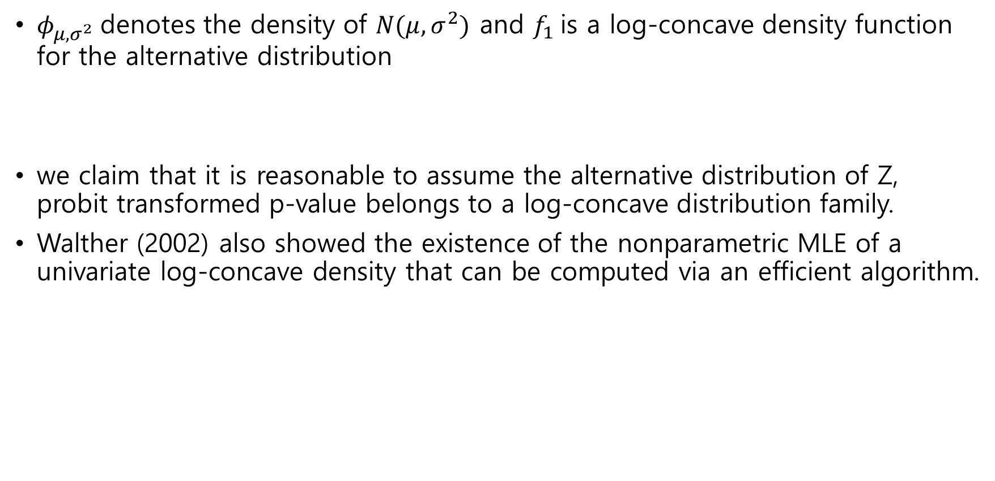
Semiparametric Mixture Model
$φ_{μ, σ^{2}}$denotes the density of $N(μ, σ^{2})$ and $f_{1}$is a log-concave density function for the alternative distribution
we claim that it is reasonable to assume the alternative distribution of Z, probit transformed p-value belongs to a log-concave distribution family.
Walther (2002) also showed the existence of the nonparametric MLE of a univariate log-concave density that can be computed via an efficient algorithm.

Slide 6
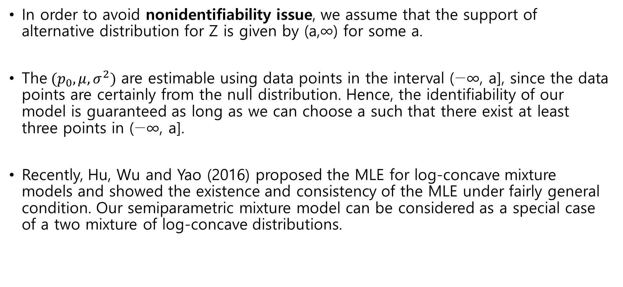
Semiparametric Mixture Model - consistency
In order to avoid nonidentifiability issue, we assume that the support of alternative distribution for Z is given by (a,∞) for some a.
The$(p_{0},μ, σ^{2})$ are estimable using data points in the interval (−∞, a], since the data points are certainly from the null distribution. Hence, the identifiability of our model is guaranteed as long as we can choose a such that there exist at least three points in (−∞, a].
Recently, Hu, Wu and Yao (2016) proposed the MLE for log-concave mixture models and showed the existence and consistency of the MLE under fairly general condition. Our semiparametric mixture model can be considered as a special case of a two mixture of log-concave distributions.
Notes:
두번째단락

Slide 7
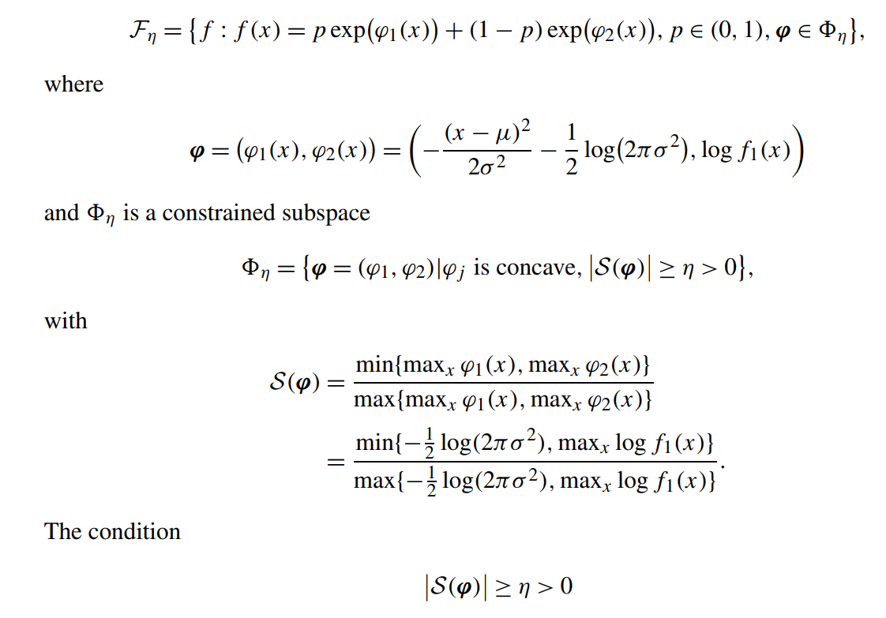

Semiparametric Mixture Model – consistency
Key idea is to prevent the likelihood from being unbounded by constraining the parameter space. Hence, it suffices to check whether our semiparametric mixture model satisfies $f∈F_{η}$ for some $η∈(0,1]$ where $F_{η}$is defined as follows:
is satisfied as long as the mode of alternative density does not increase to ∞, and it is not so much a restrictive one for any alternative density.
Notes:
S(phi) 가 저 조건을 만족하면 MLE를 찾을 수 있다는 뜻인지?

Slide 8
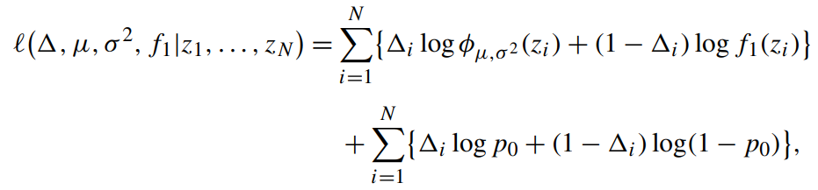
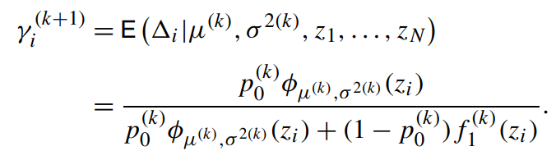
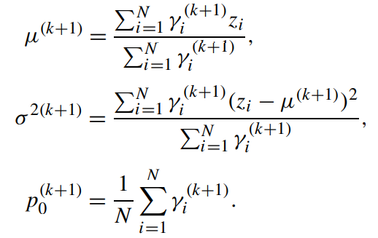
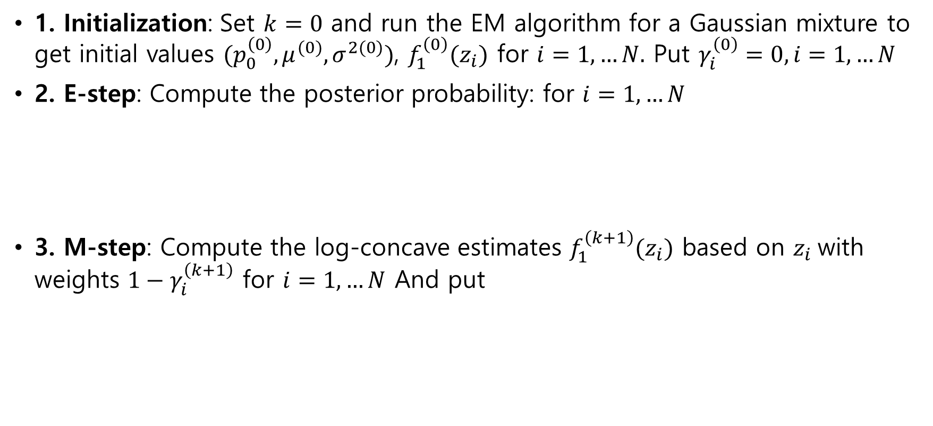
EM algorithm
1. Initialization: Set $k=0$ and run the EM algorithm for a Gaussian mixture to get initial values $(p_{0}^{\left(0\right)}, μ^{(0)}, σ^{2(0)})$, $f_{1}^{\left(0\right)}(z_{i})$ for $i=1,…N.$ Put $γ_{i}^{\left(0\right)}=0, i=1,…N$
2. E-step: Compute the posterior probability: for $i=1,…N$
3. M-step: Compute the log-concave estimates $f_{1}^{\left(k+1\right)}(z_{i})$ based on $z_{i}$with weights ${1−γ}_{i}^{\left(k+1\right)}$ for $i=1,…N$ And put
Notes:
Initialization gaussian mixture로 initial value를 구한다는게 무슨의미인지?
M step에서 감마를 통해 어떻게 f_1의 estimate을 구하는지?

Slide 9

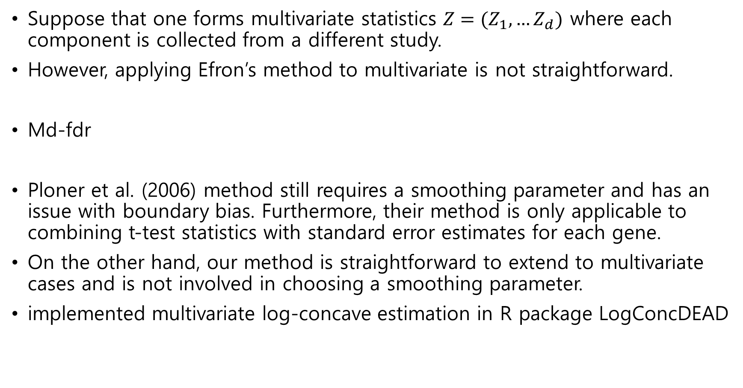
Extension to Multiple Studies
Suppose that one forms multivariate statistics $Z=(Z_{1},…Z_{d})$ where each component is collected from a different study.
However, applying Efron’s method to multivariate is not straightforward.
Md-fdr
Ploner et al. (2006) method still requires a smoothing parameter and has an issue with boundary bias. Furthermore, their method is only applicable to combining t-test statistics with standard error estimates for each gene.
On the other hand, our method is straightforward to extend to multivariate cases and is not involved in choosing a smoothing parameter.
implemented multivariate log-concave estimation in R package LogConcDEAD
Notes:
Efron’s method?
우리의 model에서는 f와 f_0가 어떻게 construct 되는지?

Slide 10
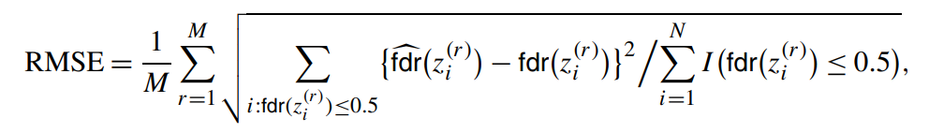
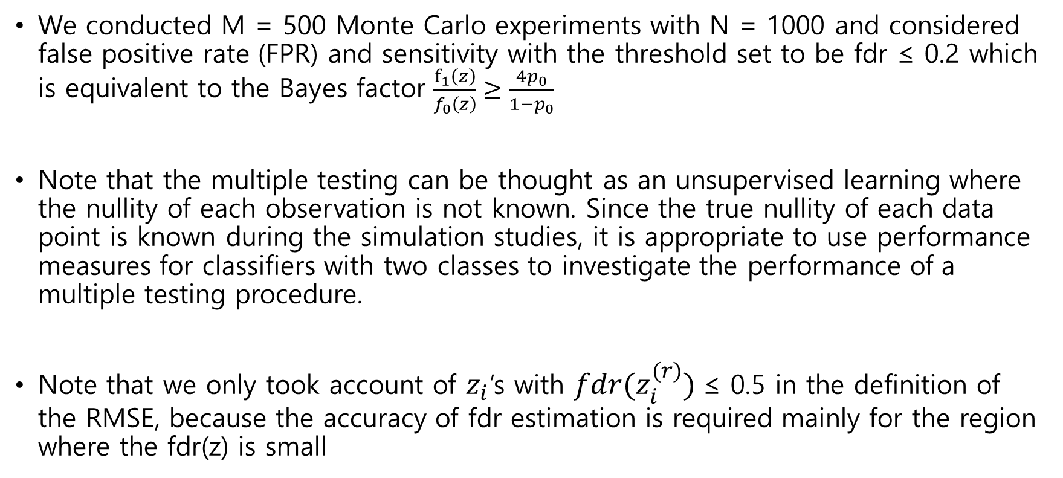
Simulation Studies
We conducted M = 500 Monte Carlo experiments with N = 1000 and considered false positive rate (FPR) and sensitivity with the threshold set to be fdr ≤ 0.2 which is equivalent to the Bayes factor $\frac{f_{1}\left(z\right)}{f_{0}\left(z\right)}≥\frac{4p_{0}}{1−p_{0}}$
Note that the multiple testing can be thought as an unsupervised learning where the nullity of each observation is not known. Since the true nullity of each data point is known during the simulation studies, it is appropriate to use performance measures for classifiers with two classes to investigate the performance of a multiple testing procedure.
Note that we only took account of $z_{i}$’s with ${fdr(z}_{i}^{(r)})$≤ 0.5 in the definition of the RMSE, because the accuracy of fdr estimation is required mainly for the region where the fdr(z) is small
Notes:
M=500 monte carlo with N=1000?
Threshold라는게 fdr<=0.2이면 H1 이라고 생각?
왜 0.5보다 작은값만 사용?

Slide 11
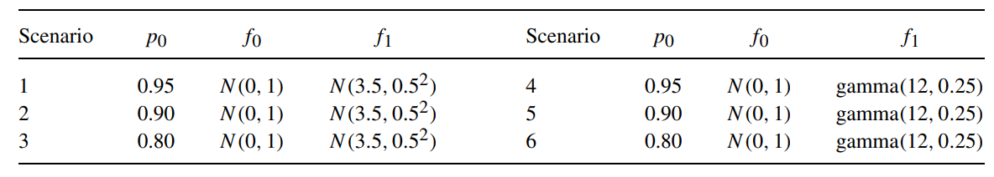
Simulations of Single Studies
we may practically reckon that they are supported on a bounded interval given by the range of ±3 standard deviation around its mean;
Gamma distributions are log concave and are supported on (0,∞), so that there is no issue on the identifiability

Slide 12
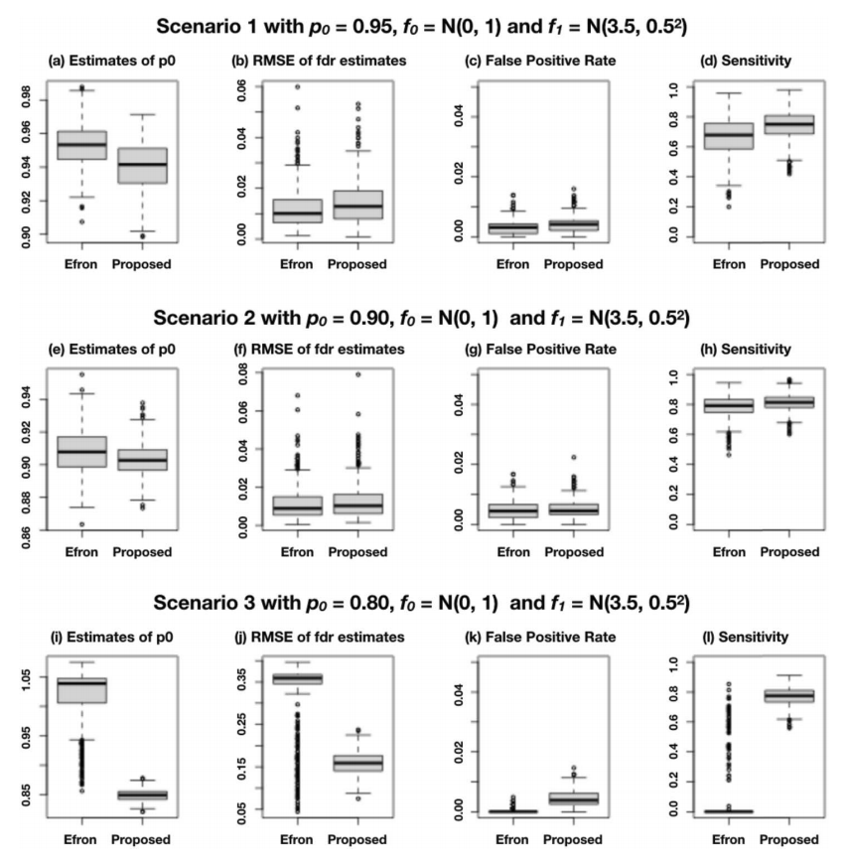
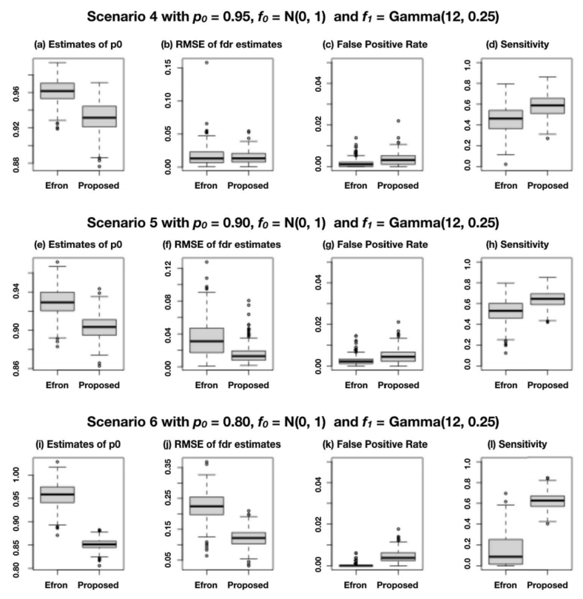
Simulations of Single Studies
In the settings with p0 = 0.95 and p0 = 0.90, both Efron’s and our method worked reasonably well. However, when p0 = 0.80, Efron’s method tends to overestimate p0 and RMSE becomes substantially large. Furthermore, their sensitivity is closer to 0 in most

Slide 13
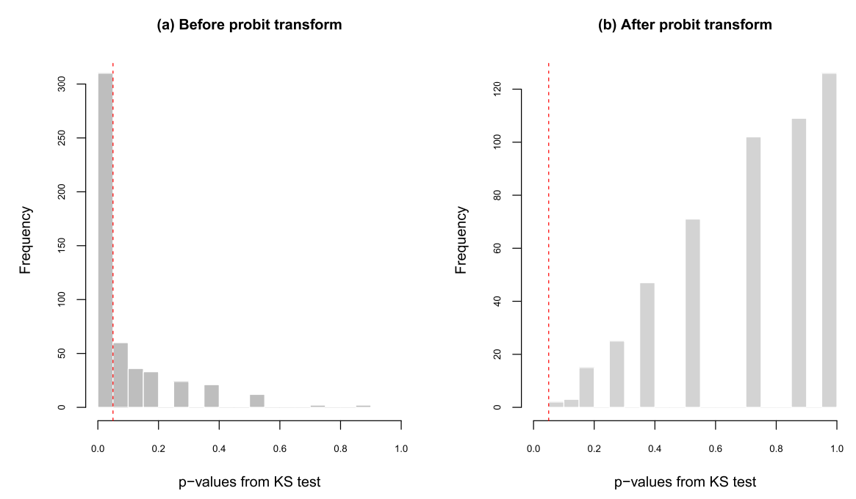
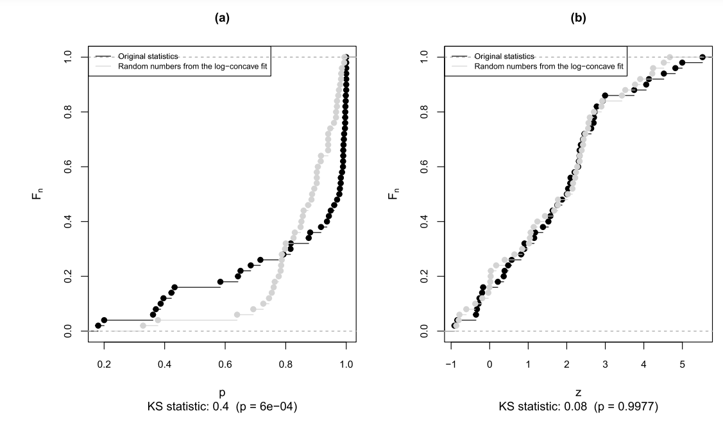
Simulations of Single Studies
Our log-concavity assumption is indeed robust in testing problems.
To check this, we simulated p-values from Beta(0.3, 1) that does not satisfy log-concavity. But we verified that the distribution of probit transformed p-values gets quite close to a log-concave one.
We repeated the above procedure 500 times. While most of the KS test p-values are small, after the probit transformation only 0.2% of the KS tests have p-values less than or equal to 0.05

Slide 14
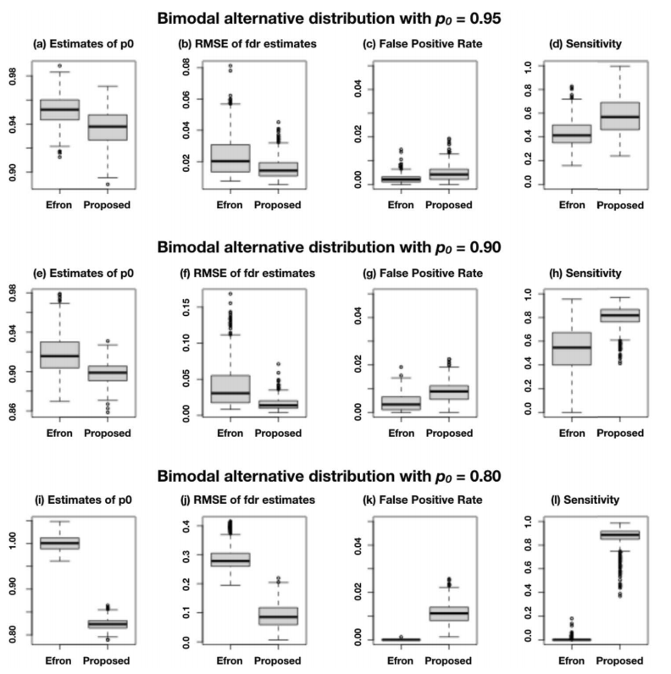
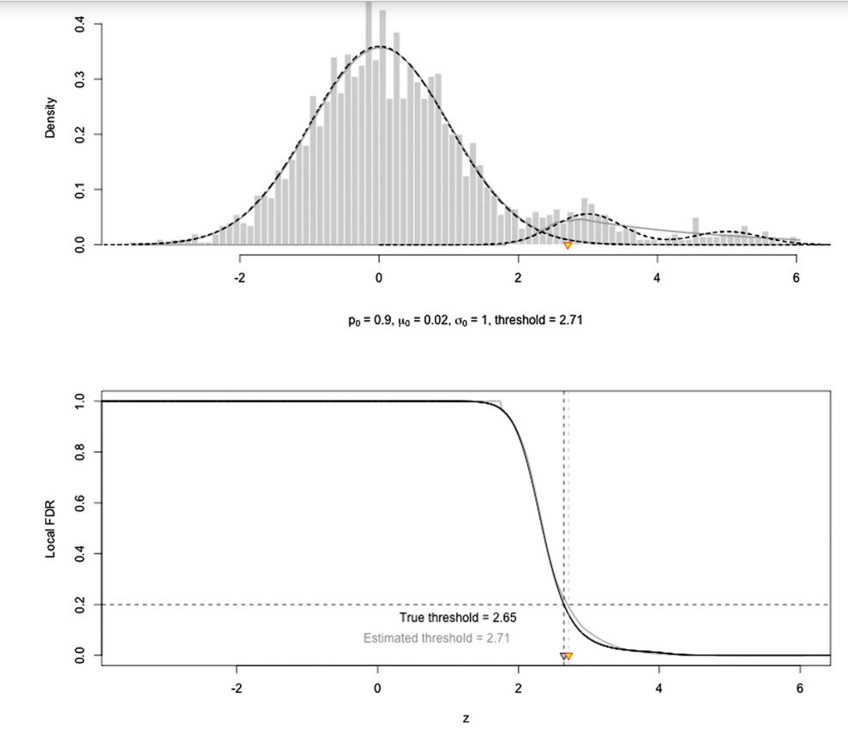
Simulations of Single Studies
Our method overestimates the alternative density (underestimating fdr). However, this area should be declared as alternative, so underestimating fdr should not be an issue.
Proposed method is robust even if the alternative distribution violates the log-concavity assumption.
Our fdr estimator around boundary is robust even when log-concavity assumption is violated
Notes:
Boundary 근처에서 fdr이 작으면 좋은가?

Slide 15
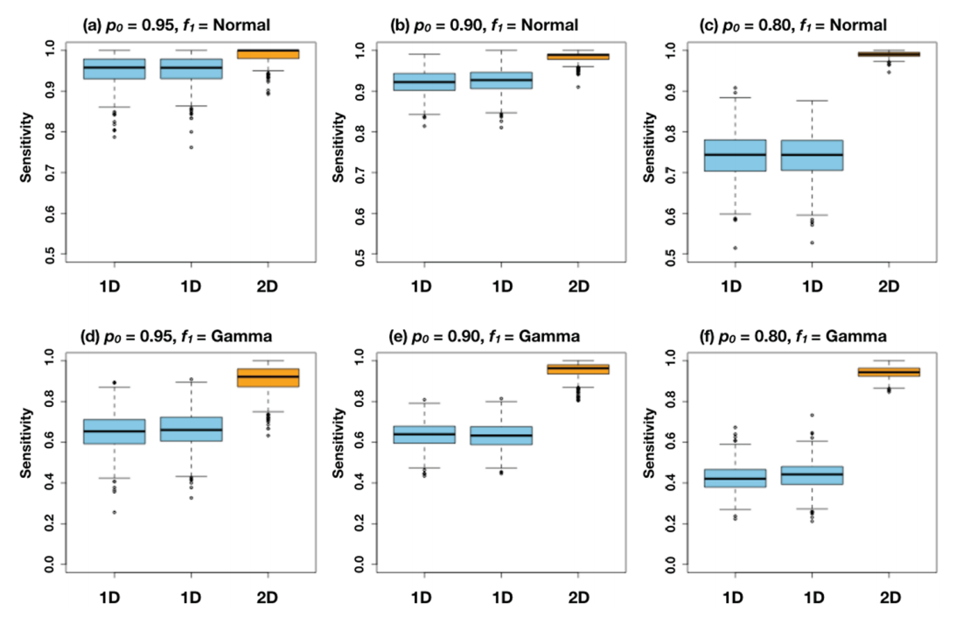
Simulations of Multiple Studies
All the figures commonly show that md-fdr outperforms 1d-fdr.
Notes:
Sensitivity가 커지면 좋은 것?

Slide 16
Common pathways across multiple studies
By applying our model to each list of p-values separately, there were 26, 32 and 26 pathways with 1d-fdr < 0.1 for study (1), (2) and (3), respectively. When we fitted our model to estimate md-fdr of three lists of p-values, there were 23 pathways with md-fdr < 0.1.
Notes:
Fdr이 0.1보다 작다는 게 무슨 의미? 질병이 있다는 의미?

Slide 17
Common pathways across multiple studies
Our methods could identify more pathways with md-fdr< 0.1, but not necessarily all the 1d-fdr< 0.1. For examples, osteoclast differential pathway had the 1d-fdr< 0.1 in the sinus brushings study only, while cell-surface interactions at the vascular wall pathway had the 1d-fdr< 0.1 in the sinus-brushings and the orbital-tissue studies. The former is known to be important in the pathogenesis of AAV, and the latter is highly relevant in vasculitis.
Notes:
여러 pathway 중에서 1-d만 사용하는 거는 중요한 pathogenesis(발병원인)을 찾아내지 못할수도

Slide 18
Discussion
We presented an EM-type algorithm to implement the proposed estimators for both single high-dimensional and multiple high-dimensional testing results.
Our method can estimate fdr and the proportion of the null simultaneously and fit the alternative when necessary.
Our method is easy to use because it does not require smoothing parameter selection.
Our simulation studies showed that the proposed method outperforms other existing method in both single study and multiple studies.
We presented an application which demonstrates the unique feature of the proposed semiparametric mixture model and, especially, the advantage of using md-fdr over 1d-fdr
Conclusion not ended(오타?)

Slide 19
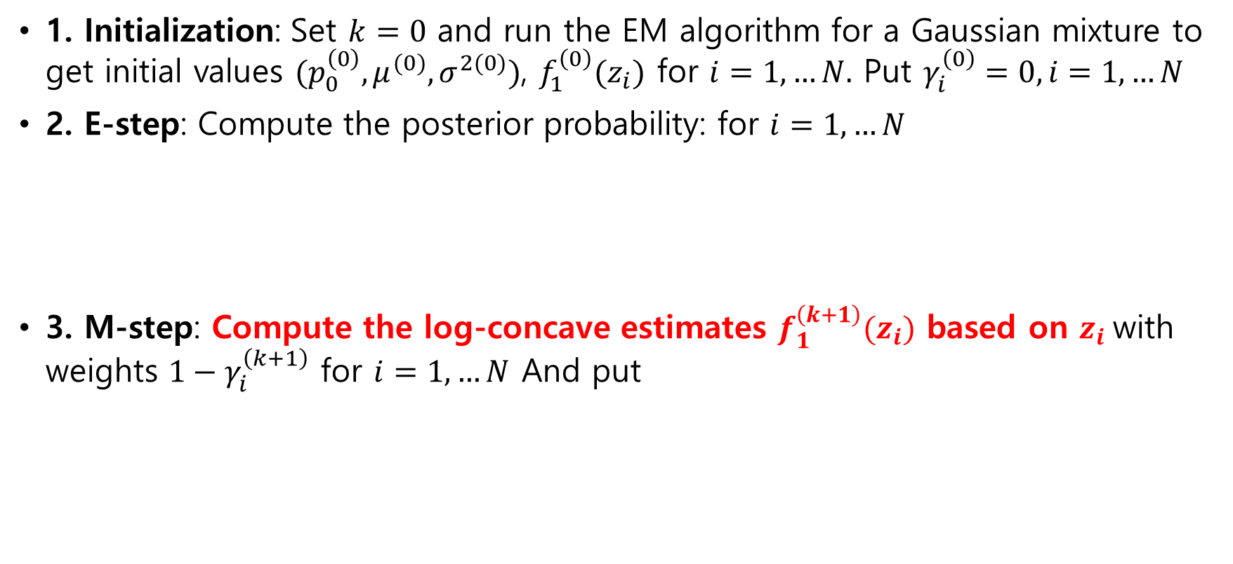
EM algorithm
1. Initialization: Set $k=0$ and run the EM algorithm for a Gaussian mixture to get initial values $(p_{0}^{\left(0\right)}, μ^{(0)}, σ^{2(0)})$, $f_{1}^{\left(0\right)}(z_{i})$ for $i=1,…N.$ Put $γ_{i}^{\left(0\right)}=0, i=1,…N$
2. E-step: Compute the posterior probability: for $i=1,…N$
3. M-step: Compute the log-concave estimates $f_{1}^{\left(k+1\right)}(z_{i})$ based on $z_{i}$with weights ${1−γ}_{i}^{\left(k+1\right)}$ for $i=1,…N$ And put
Notes:
Initialization gaussian mixture로 initial value를 구한다는게 무슨의미인지?
M step에서 감마를 통해 어떻게 f_1의 estimate을 구하는지?

Slide 20
